Slide 1
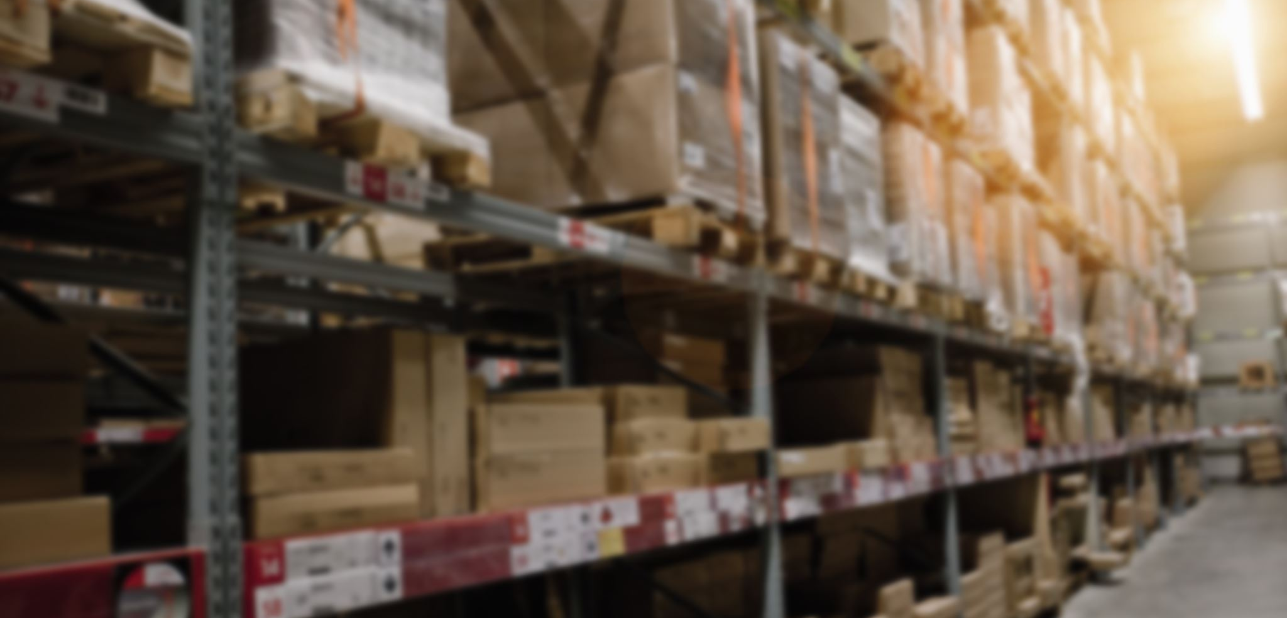
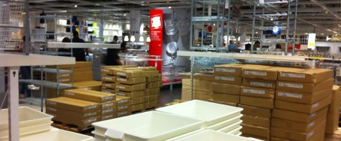
Inventory

Slide 2
Purchase order process flow
No
Align with the commercial team to adjust the PO
Purchase Order creation “ PO “
Top management approval
Goods Received
Quantity matching with the PO?
Yes
Operation inbound - Delivery Note “ DN “
Vendor invoice received
Three-way matching
Invoice = PO & DN?
Invoice recording
Yes
Vendor payment
Align with the vendor to adjust the invoice
No

Slide 3
Inventory Accounting cycle
Goods received from the vendor “ Inbound”
Cost of goods sold “Outbound”
DR
Inventory
DR
COGS
CR
Inventory Accrual
CR
Inventory
Invoice received from the vendor “ 3-way matching”
Lost inventory items “Cycle count”
DR
Inventory Accrual
DR
Inventory write-off expense
CR
Vendor
CR
Inventory
Vendor payment
Write-down inventory “Slow moving items”
DR
Vendor
DR
Inventory write-down expense
CR
Bank
CR
Inventory

